Slide 1
Counting & Claiming
2024 – 2025

Slide 2
Overview & Purpose
This training will provide updated procedures for counting and claiming meals in the 2024-2025 school year. The purpose of this training is to identify and understand the following:
Universal Meals
Medium of Exchange and Cash Collection
Benefit Issuance Documents (Rosters)
Point of Service (POS) Failure Solutions

Slide 3
UNIVERSAL MEALS
California has become the first state to implement a statewide Universal Meal Program for all school children. California’s Universal Meal Program is designed to build
on the foundations of the federal National School Lunch Program (NSLP) and School Breakfast Program (SBP).

Slide 4
INTEGRITY PLAN
LAUSD Food Services Division (FSD) has established procedures to affirm meal counts to support reimbursement.
The Food Service Manager (FSM) will use the Meal Count Consolidation Form for meal periods with more than one meal count sheet.
The FSM will run a weekly Meal Counts Report to check for accuracy.
The Area Food Services Supervisors (AFFS) will conduct a minimum of two meal count monitor per site before December 15th 2024, and May 15th 2025.

Slide 5
ELEMENTARY SITE INTEGRITY PLAN
The integrity plan is implemented to prevent incorrect meal claims. The FSD is required to have an integrity plan with preventative measures in place to prevent meal over- and under-claiming.
Students are only permitted one meal at no charge per day for breakfast, lunch, and supper.
By having elementary student say their name at the POS, the delay allows for the cashier to verified if the meal is reimbursable.

Slide 6
SECONDARY SITE INTEGRITY PLAN
The FSD submitted an integrity plan to the state to prevent inaccurate meal claims, including preventative measures.
Students are only permitted one meal at no charge per day for breakfast, lunch, and supper.
By having secondary student use the pin pad at POS and input "9" and "ENTER,” the line is delayed enough to allow the cashier to verify if the meal is reimbursable.

Slide 7
STUDENT ACCOUNTS
Although students eat at no charge, students can still purchase additional items using money in their account. Students can continue to load funds into their account via My Payment Plus.
Managers can offer assistance by directing parents to
the My Payments Plus website at
https://www2.mypaymentsplus.com/welcome
My Payments Plus link on the Food Services website

Slide 8
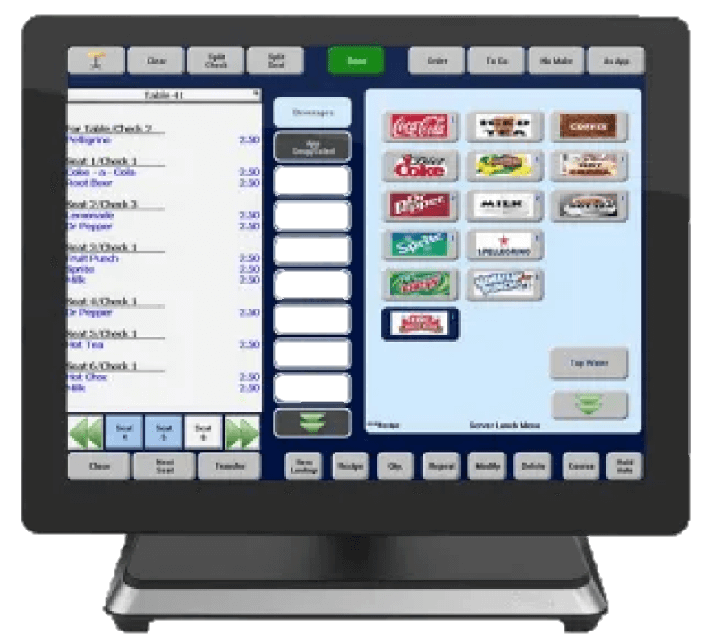
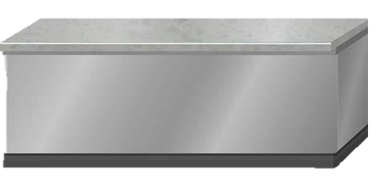
BREAKFAST
MEDIUM OF EXCHANGE

Slide 9
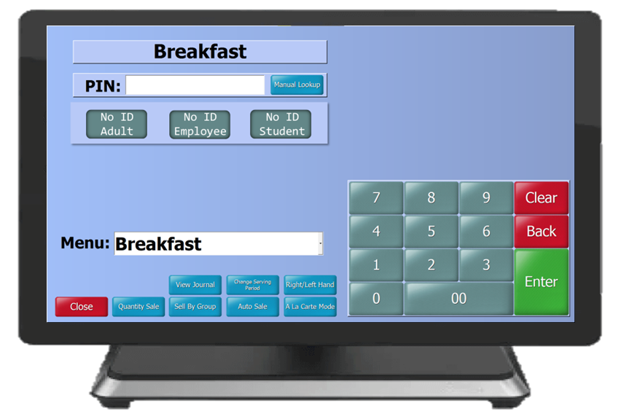
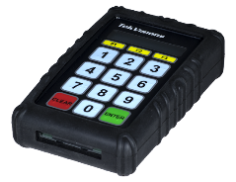
BREAKFAST MEDIUMS OF EXCHANGE
Breakfast meal counts will be conducted according to the counting and claiming method per meal service model.
Breakfast at Mobile Carts
And Cafeteria Service
Cafeteria Service
Elementary and Secondary Sites
Daily Meal Count Form
Meal Consolidation Form
(BIC)
Elementary sites
FSD staff will select the "No ID Student" button at POS to claim meal
Secondary sites
Students press “9" and then press "ENTER" on the pin pad to claim meal

Slide 10
Claiming Connectivity Activity 1
What breakfast medium of exchange IS UTILIZED at your school?
Refer to the activity sheet

Slide 11
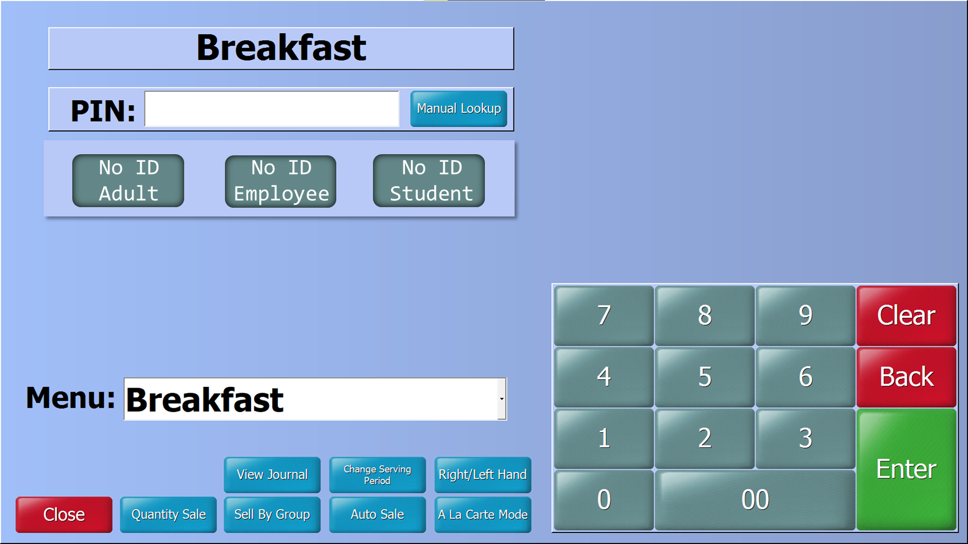
ELEMENTARY
CAFETERIA BREAKFAST SERVICE
POS cashiers at elementary sites will identify each student and ensure they take a reimbursable meal before claiming the breakfast meal using the “No ID Student” button.

Slide 12
SECONDARY
CAFETERIA BREAKFAST SERVICE
At secondary sites, cashiers ensure students take a reimbursable meal before the student uses the pin pad to select “9” and “ENTER” to claim the breakfast meal.
9

Slide 13
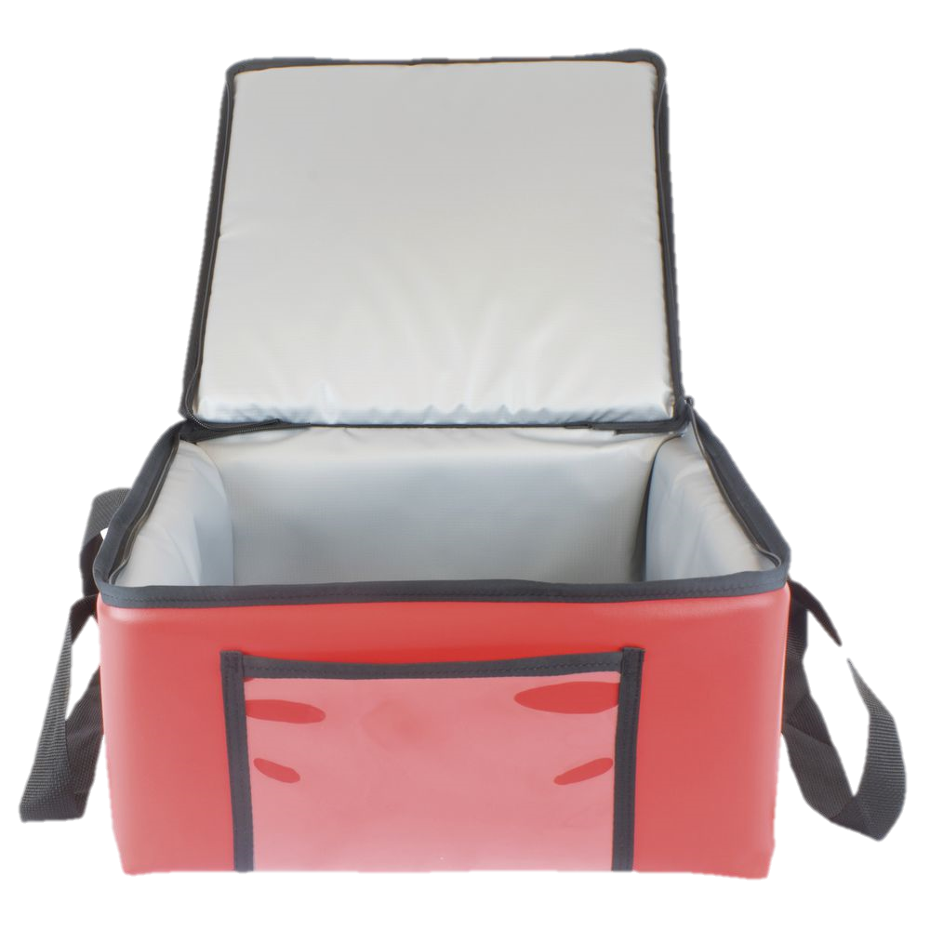
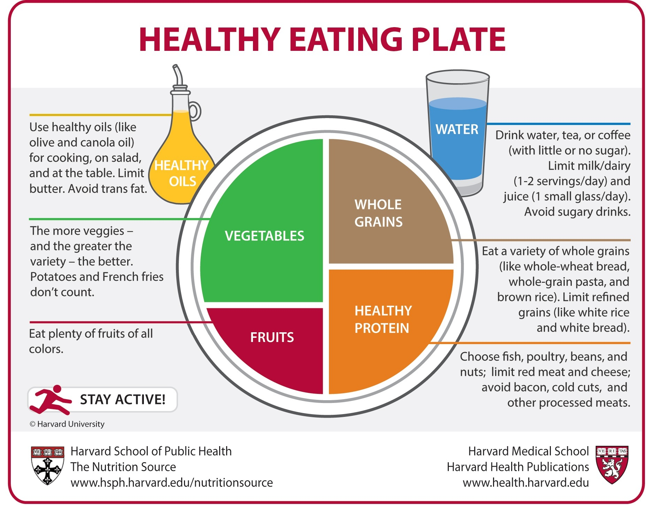
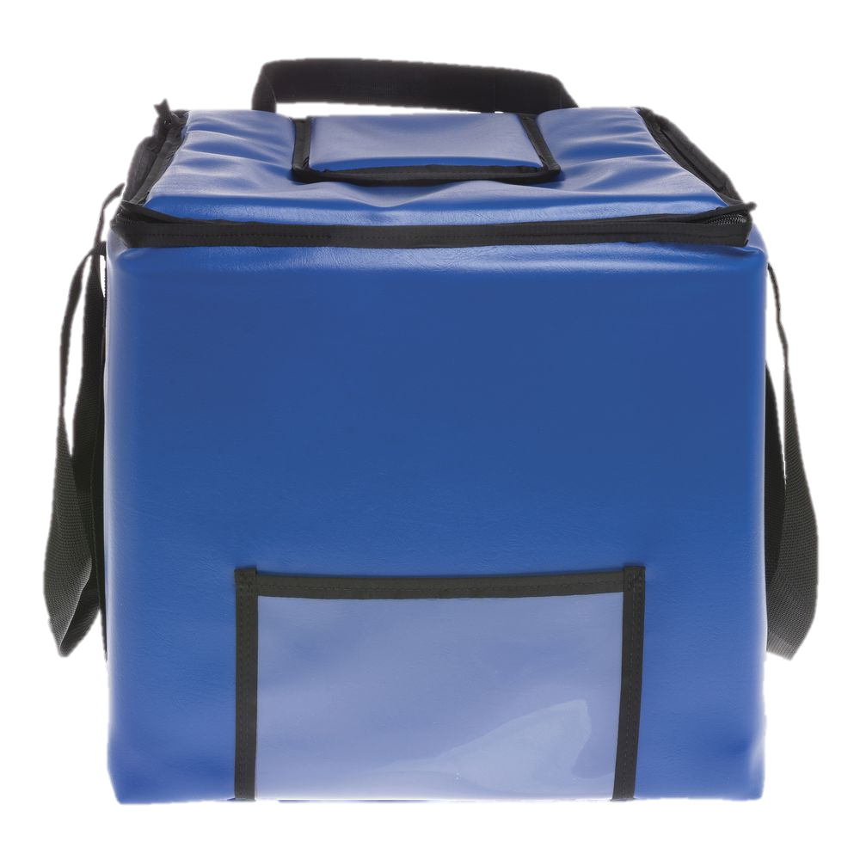
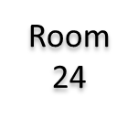
BIC
MEDIUM OF EXCHANGE FOR ALL SITES
Breakfast Rules
Why breakfast is so important?
Essential Nourishment
Increased Energy
Better Mood
Improved Concentration
Take an entrée
Choose a fruit or juice
Additional option
Milk
The teacher or designated adult will cross off numbers on the Breakfast Meal Count Form as each student selects a reimbursable breakfast meal.
Notes:
Click to show students’ breakfast selection, ask “ Is this a reimbursable breakfast?”
Click again to reveal the answer

Slide 14
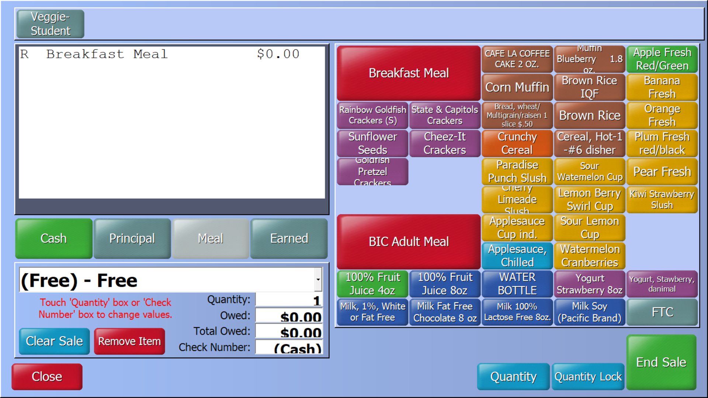
BIC COUNTING AND CLAIMING PROCEDURES
BIC sites will use the total meal counts from the Breakfast Daily Meal Count Consolidation form to input a quantity sale in CMS.
Verify that all classroom meal count forms have been collected and inputted onto the BIC Daily Meal Count Consolidation Form before completing a quantity sale.
Collect all Breakfast Meal Count Forms
Input counts onto BIC Daily Meal Consolidation form
Use BIC Daily Meal Consolidation sheet to input quantity sale

Slide 15
LUNCH
MEDIUM OF EXCHANGE

Slide 16
ELEMENTARY LUNCH MEDIUM OF EXCHANGE
Students enter the meal service lines by classroom and state their names while at the POS.
This exchange helps with accurate meal counts, gives the cashier time to identify a reimbursable meal, and prevents students from receiving more than one reimbursable meal.

Slide 17
SECONDARY LUNCH MEDIUM OF EXCHANGE
FSD uses the following medium of exchange at secondary sites.
FS staff will ensure a reimbursable meal is selected before claiming the meal.
If a reimbursable meal was not selected, verbally ask the student to take another Item.
If a reimbursable meal is not selected, charge items as a la carte.
Student press “9” and “ENTER” on pin pad to claim a reimbursable meal.

Slide 18
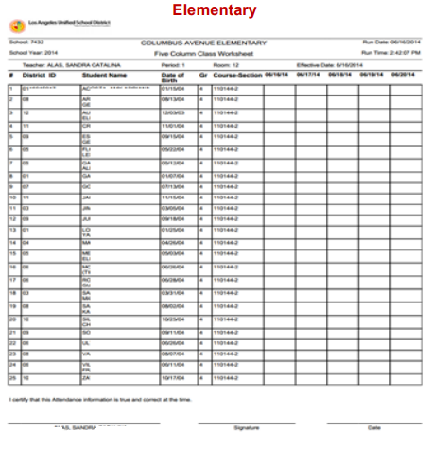
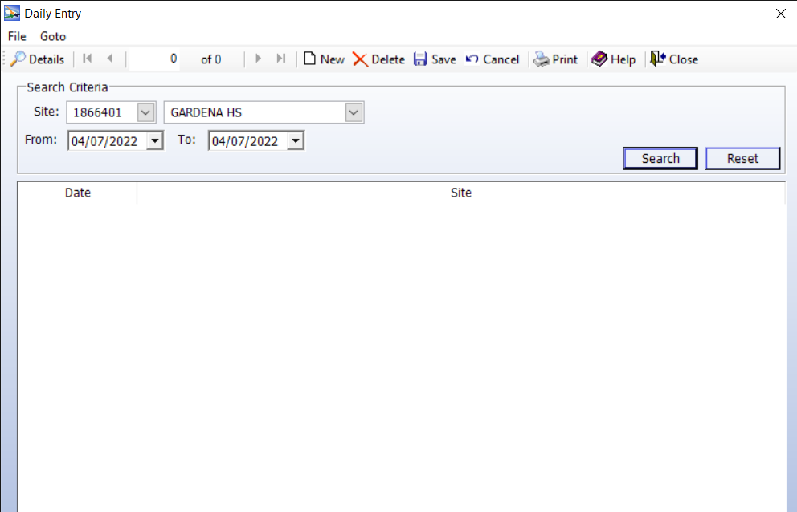
COUNTING & CLAIMING PROCEDURES
FOR CSPP
California State Preschools Programs (CSPP) will use classroom rosters to account for student meals.
Claim meals by completing a Daily Entry in CMS for CSPP site using the dropdown.

Slide 19
What number must a secondary student select on the POS pin pad to receive a reimbursable meal?
Claiming Connectivity Activity 2
0 1 2 3 4
5 6 7 8 9
Refer to the activity sheet

Slide 20
OFFSITE AND CONTINUATION PROCEDURES
OFFSITE

Slide 21
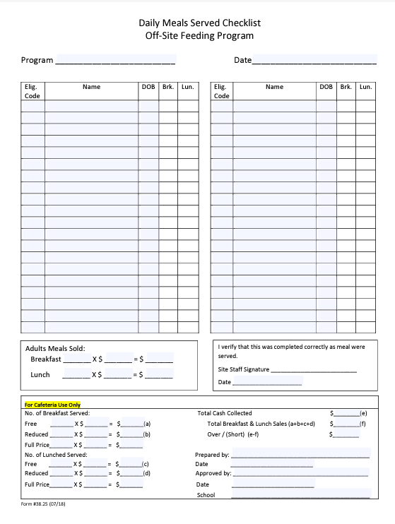
CONTINUATION & OFFSITE PROCEDURES
To account for meals at off-sites, including continuation sites, use the Daily Meal Served Checklist Off-Site Feeding Program form.
Students 21 and older pay adult prices
Students 21 and older enrolled in a special-education program qualify for meals at no charge
Meals from continuation and offsites are claimed by completing a Daily Entry for each offsite using the dropdown in CMS.

Slide 22
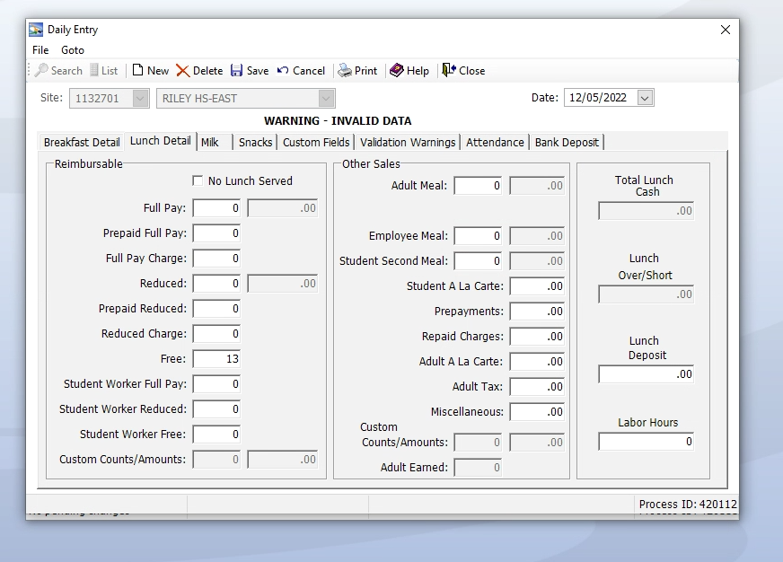
DAILY ENTRY FOR OFFSITES
Meals are claimed by completing a “Daily Entry” for each offsite using the dropdown in CMS.
Offsites will claim meal counts as FREE in “Daily Entry” utilizing the correct meal period.

Slide 23
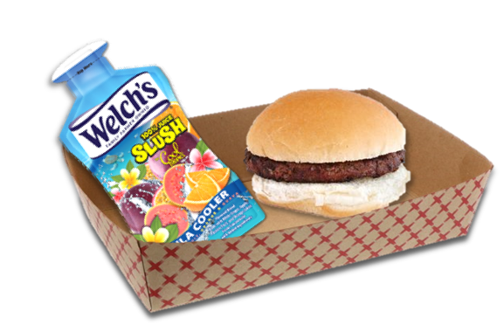
SUPPER

Slide 24
COUNTING & CLAIMING PROCEDURES FOR SUPPER
Students participating in supper, will give their name in exchange for a meal.
Supper carts will be set up near designated eating areas
Community Rosters will be used to account for meals served to students receiving a meal and not enrolled in an ASP
ASP Supper Grid Sheet will be used to account for enrolled students receiving a meal
Community
ASP

Slide 25
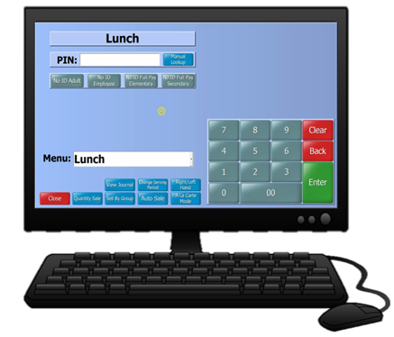
SUPPER CMS ENTRY
After collecting Community Rosters and ASP Supper Grid Sheet, total meals will be tallied and claimed in CMS by completing a Daily Entry.
Community
+
ASP

Slide 26
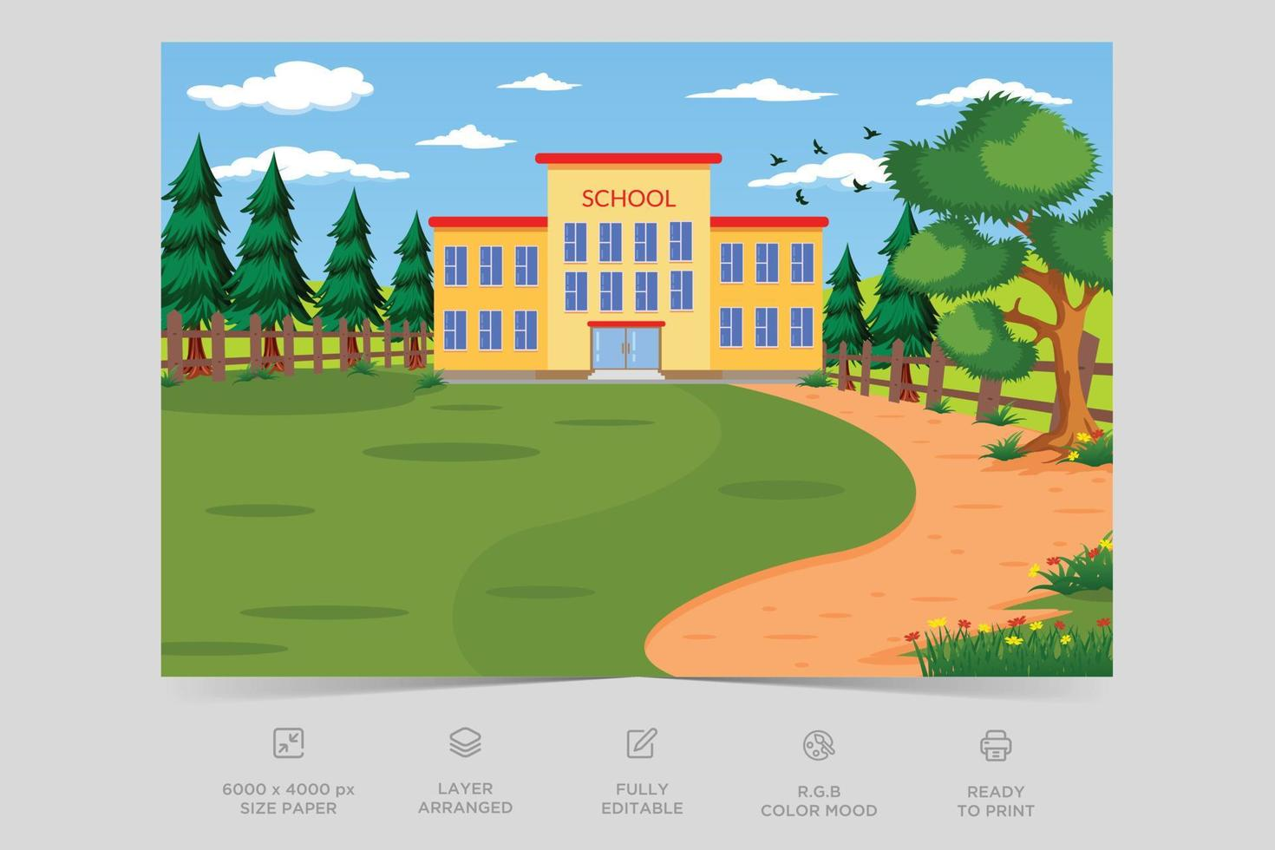
Claiming Connectivity
Activity 3
What does the community participating in supper provide in exchange for a meal?
Their Name
Refer to the activity sheet

Slide 27
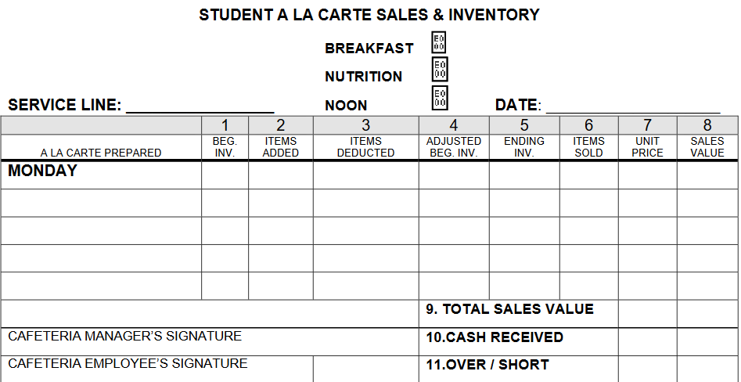
NON – REIMBURSABLE MEALS
A non-reimbursable meal is a meal that does not contain the minimum required number of components.
Encourage students to add another component to make the meal reimbursable
Cafeterias will have a basket of fruits and cold vegetables at the POS to assist students in making meal selections.
If a student declines, charge items at an a la carte price.
Do not claim as a reimbursable meal.

Slide 28
NON – REIMBURSABLE MEALS
Cafeterias will have a basket of fruits and vegetables at each POS to assist students in completing the meal selection.

Slide 29
WHAT COULD BE INCLUDED IN THE BASKET AT THE POS TO GUIDE STUDENTS IN SELECTING A REIMBURSABLE MEAL?
Claiming Connectivity Activity 4
Refer to the activity sheet

Slide 30
MEAL BENEFIT ISSUANCE DOCUMENTS
ROSTER MAINTENANCE
CMS and MiSiS Rosters are to be printed monthly on the first of every month.
CEP
MiSiS Meal Program Roster
Monthly
CMS Customer Roster Report
Monthly
Monthly
1

Slide 31
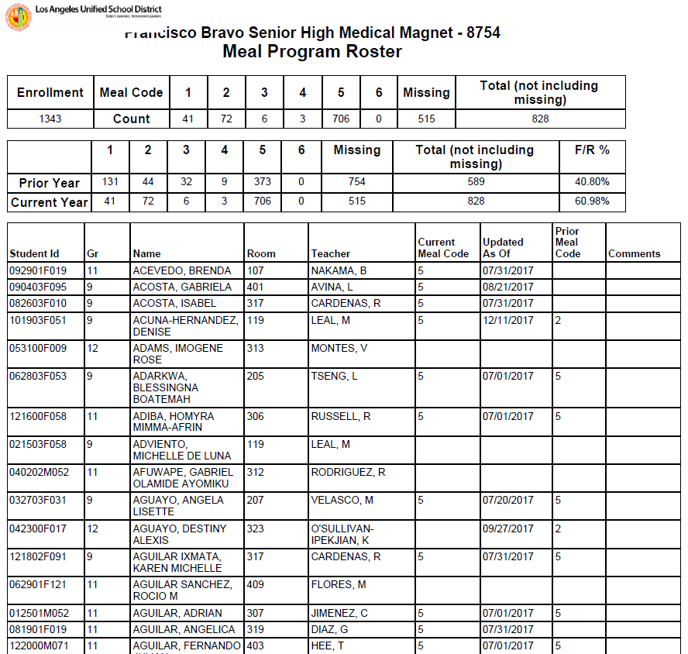
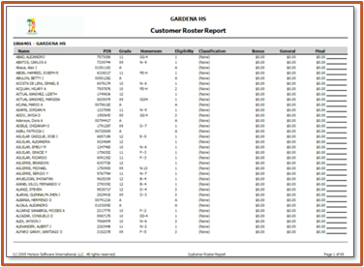
CMS AND MiSiS ROSTERS
Rosters are a significant component of compliance. CMS and MiSiS Rosters are printed and retained to ensure accurate student enrollment.
Print in alphabetical order or by classroom
Manually write the date range on the roster
File past rosters with the most current in front
Keep on file for 3 years + the current year.

Slide 32
ACCOUNTABILITY
School Food Authorities (SFA) must have policies and procedures to prevent meal over- and under-claiming. LAUSD implements the following practices as a safeguard to address this issue.
Attendance Factor
Edit Check
Site Monitoring
CAFETERIA

Slide 33
ATTENDANCE FACTOR
Determined by the federal government for the 2024- 2025 school year, ADA is 95.2 %.
The average daily attendance (ADA) factor accounts for the difference between enrollment and attendance for that school district based on the information submitted in the previous year:
Schools that exceed the 95.2% ADA must annually submit attendance documentation to validate the increase in their daily attendance factor.

Slide 34
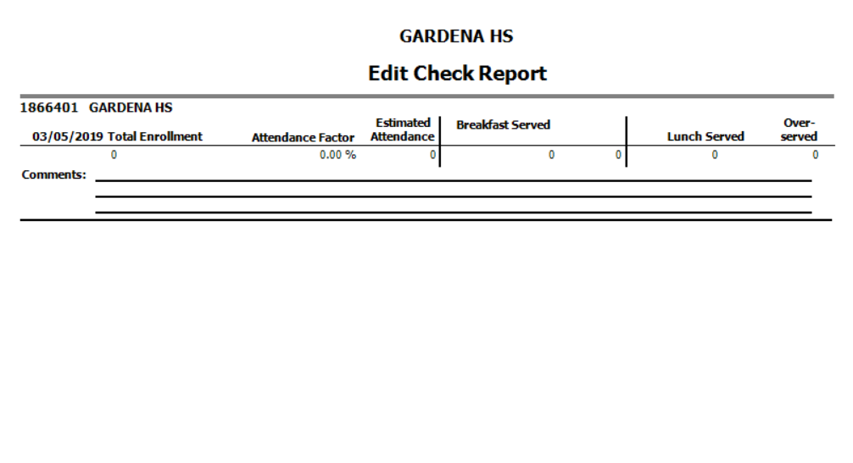
EDIT CHECK
The edit check is an accountability process developed to improve accuracy of reimbursement claims by the SFA:
Only one reimbursement claim per meal, per student,
per day:
Breakfast
Lunch
Snack
Supper
SFAs are required to repay any state/federal over-claimed meals.

Slide 35
SITE MONITORING – ANNUAL ACCUCLAIM
Federal regulations require one on-site review by January 31st of each year.
AFSS conducts the review.
The AFSS is given 45 calendar days from the review
date to follow up on any corrective actions necessary.
SFA’s are required to provide training for employees.
FSD offers the following trainings:
Annual FSM orientation
Professional Standards
New employee training (NET and MCC)
ServSafe
Follow up training and monitoring’s as needed

Slide 36
FSM ANNUAL SITE MONITORING
The FSM is responsible for conducting 2 annual site monitoring for CACFP supper program.
Days of the week and dates must vary
AFSS will assign a monitoring date to FSM

Slide 37
SPECIAL CIRCUMSTANCES AND MEAL COUNTS
Special circumstances can affect the current counting and claiming process of utilizing the POS to record meals served. During these circumstances, Breakfast/Lunch Meal Count Form is used in lieu of the POS.
Inclement Weather
Principal requests meals are packed for delivery to Pre-K and Kinder classrooms due to heavy rain.
POS Failure
Sewage Backup
Facilities Maintenance
Cafeteria not available for students and must serve out of auditorium or multipurpose room.

Slide 38
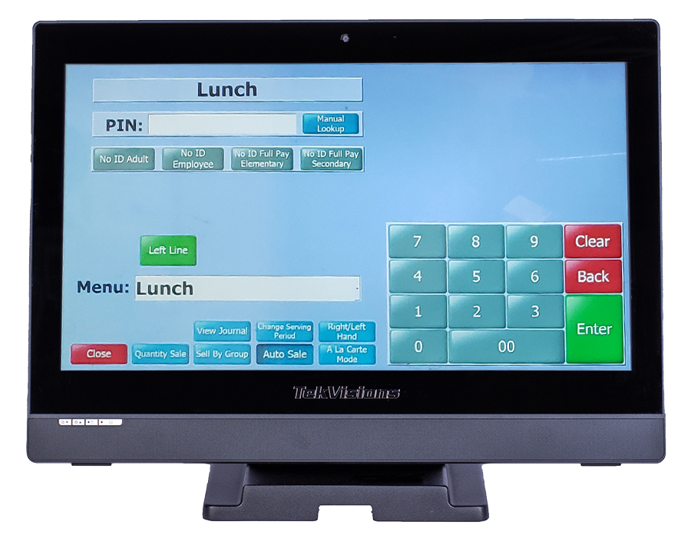
CMS POS FAILURE
In the event of a POS failure:
Submit a Remedy Ticket and inform AFSS.
Use Breakfast/Lunch Meal Count Form to account for
reimbursable meals.

Slide 39
ACCOUNTING FOR MEALS WHILE POS IS DOWN
When the computer at the POS:
Sites will use the Breakfast/Lunch Meal Count Form
Mark each meal in numerical order with a slash or X after a reimbursable meal is served.

Slide 40
CLAIMING MEALS WHILE POS IS DOWN
Use the manager’s terminal to enter the meals from the service. If the manager’s computer is also down (due to system or power failure), enter meals when the computer are connected and operable.
Open the terminal for the appropriate serving period
Enter meals served as Quantity Sale
Attach the Breakfast/Lunch Meal Count form to the day’s Production Records

Slide 41
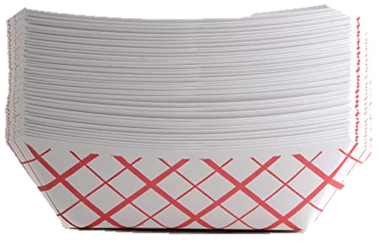
UNACCEPTABLE MEAL COUNTING METHODS
The following is a list of common errors in the meal counting process, resulting in non-reimbursable meal claims.
Counts taken anywhere other than the POS
Attendance counts
Tray or entrée counts
Classroom counts
Second meals claimed for reimbursement

Slide 42
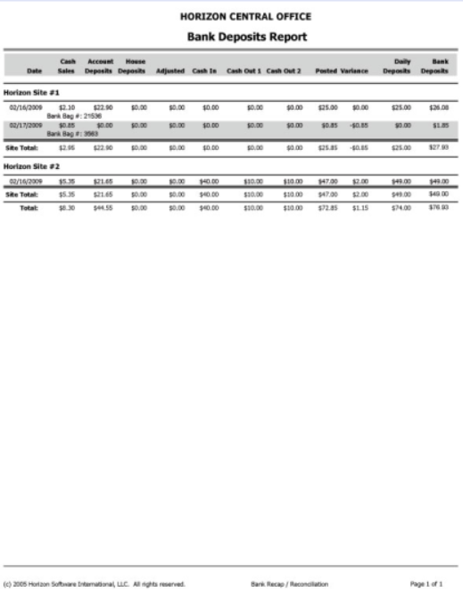
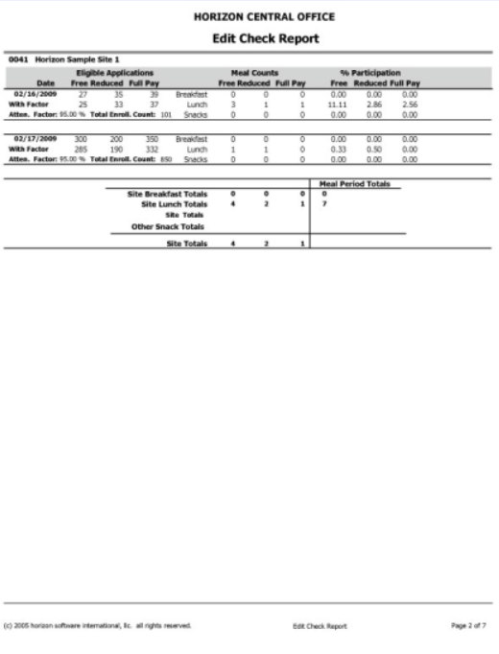
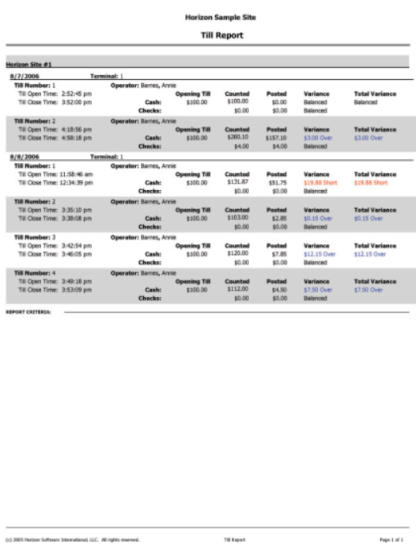
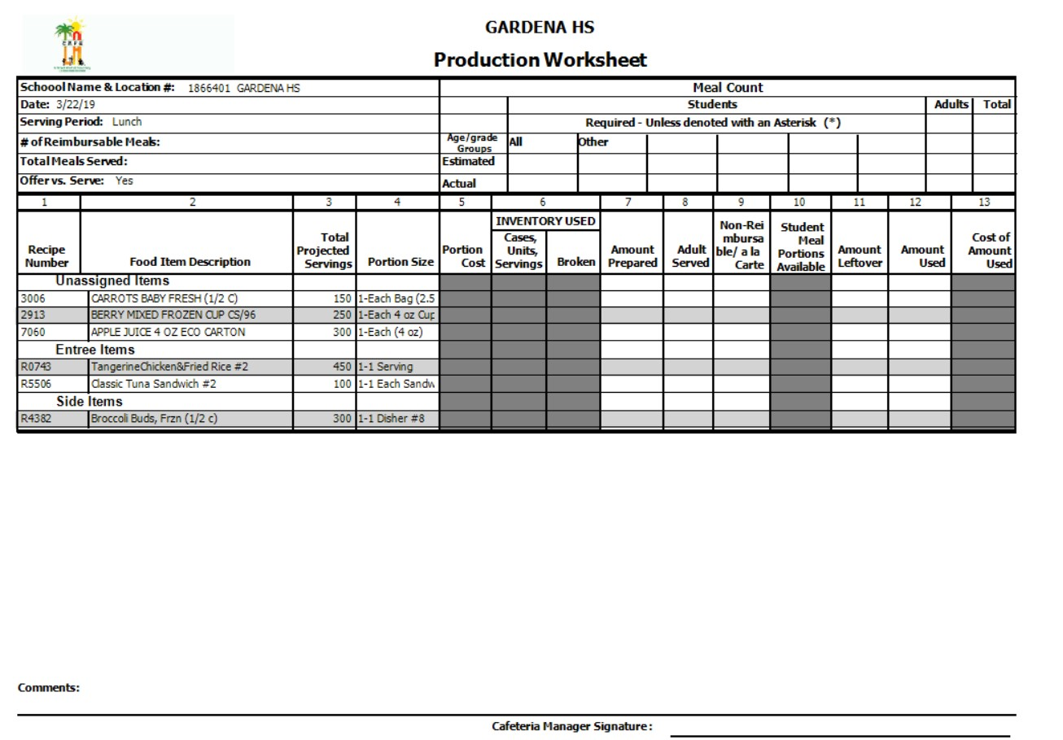
ALL–IN–ONE REPORTS
FSM will run all-in-one reports at the end of the day to review data. Managers should address any discrepancies in meal counts or variances.
After resolving the issue, rerun the reports and save them to the desktop.

Slide 43
Adult and non enrolled
student Visitors Meals
Adults:
The adult A la Carte Price List provides pricing for adults who purchase food and beverages from the school cafeteria.
Children visiting LAUSD sites:
When accounting for a reimbursable meal, the “No ID Student” button will claim CEP visiting students on the POS.
Children not currently enrolled as LAUSD students and receive breakfast or lunch will be charged as documented on the current student’s a la carte price list.

Slide 44
ACTIVITY TIME

Slide 46
Ready, set, go!!!

Slide 47
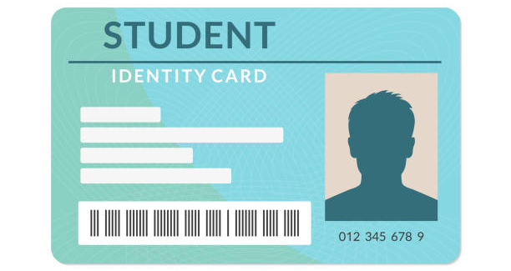
Universal ID Cards
(Coming Soon)
LAUSD FSD is expected to issue secondary school students Universal ID cards beginning January 2025.
Food Services will implement the Universal ID card in conjunction with the new CMS system.
The cashier will scan the Universal ID Card at the POS for counting and claiming of meals.
The use of ID cards will help alleviate double claiming during meal service.

Slide 48
RECAP
All schools are CEP and meal applications are not required.
MiSiS Rosters are printed monthly but no longer required
at the POS.
Elementary cashiers claim reimbursable meals by selecting the “No Student ID” button at the POS.
Secondary students will use the pin pad at the POS to
select “9” and “Enter” to claim reimbursable meals.
CAFETERIA

